Slide 1
Homework 05 Customer Lifetime Value Dashboard
BADS7105 CRM Analytics and Intelligence
Korrapin Pimapansri

Slide 2

What is CLV
CLV is the value of a customer relationship based on the present value of the projected future cash flows from relationship. It used to estimate cost for customer management. In some events, the marketer spend a lot of money for acquire new customer and retain existing customer. but they didn’t concern about return on investment.

Slide 3
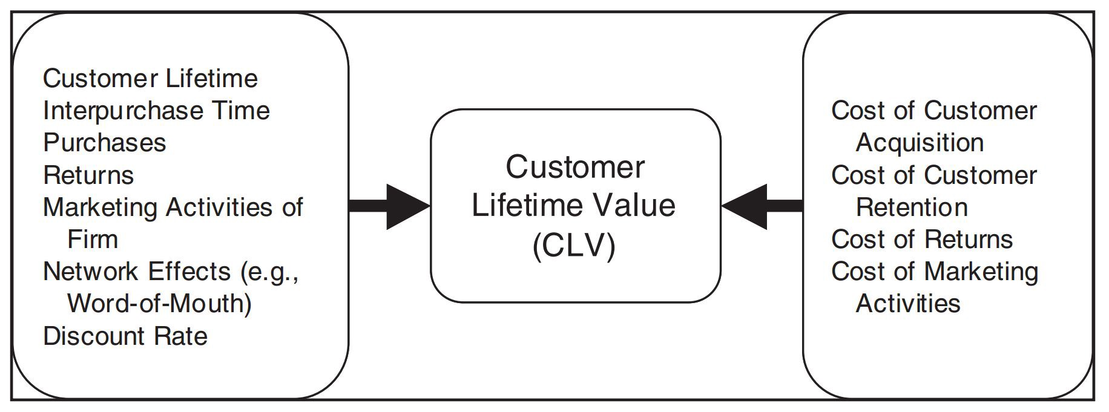
Factor relating CLV
Source : S Siddharth S. Singh, , Dipak C. Jain, “Measuring Customer Lifetime Value” In Review of Marketing Research.
Notes:
https://medium.com/madt-and-bads-nida/%E0%B8%A7%E0%B8%B1%E0%B8%94%E0%B8%A1%E0%B8%B9%E0%B8%A5%E0%B8%84%E0%B9%88%E0%B8%B2%E0%B8%82%E0%B8%AD%E0%B8%87%E0%B8%A5%E0%B8%B9%E0%B8%81%E0%B8%84%E0%B9%89%E0%B8%B2%E0%B8%94%E0%B9%89%E0%B8%A7%E0%B8%A2-customer-lifetime-value-39602559c273

Slide 4
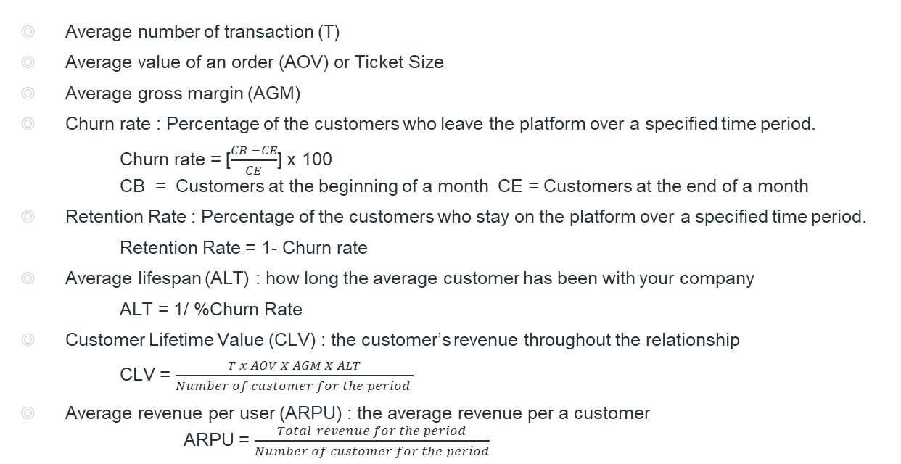
How to Measure It
Average number of transaction (T)
Average value of an order (AOV) or Ticket Size
Average gross margin (AGM)
Churn rate : Percentage of the customers who leave the platform over a specified time period.
Churn rate = [$\frac{CB −CE}{CE}$] x 100 CB = Customers at the beginning of a month CE = Customers at the end of a month
Retention Rate : Percentage of the customers who stay on the platform over a specified time period.
Retention Rate = 1- Churn rate
Average lifespan (ALT) : how long the average customer has been with your company
ALT = 1/ %Churn Rate
Customer Lifetime Value (CLV) : the customer’s revenue throughout the relationship
CLV = $\frac{T x AOV X AGM X ALT}{Number of customer for the period }$
Average revenue per user (ARPU) : the average revenue per a customer
ARPU = $\frac{Total revenue for the period}{Number of customer for the period}$
Notes:
https://medium.com/madt-and-bads-nida/%E0%B8%A7%E0%B8%B1%E0%B8%94%E0%B8%A1%E0%B8%B9%E0%B8%A5%E0%B8%84%E0%B9%88%E0%B8%B2%E0%B8%82%E0%B8%AD%E0%B8%87%E0%B8%A5%E0%B8%B9%E0%B8%81%E0%B8%84%E0%B9%89%E0%B8%B2%E0%B8%94%E0%B9%89%E0%B8%A7%E0%B8%A2-customer-lifetime-value-39602559c273
https://www.lean-case.com/customer-lifetime-value/

Slide 5
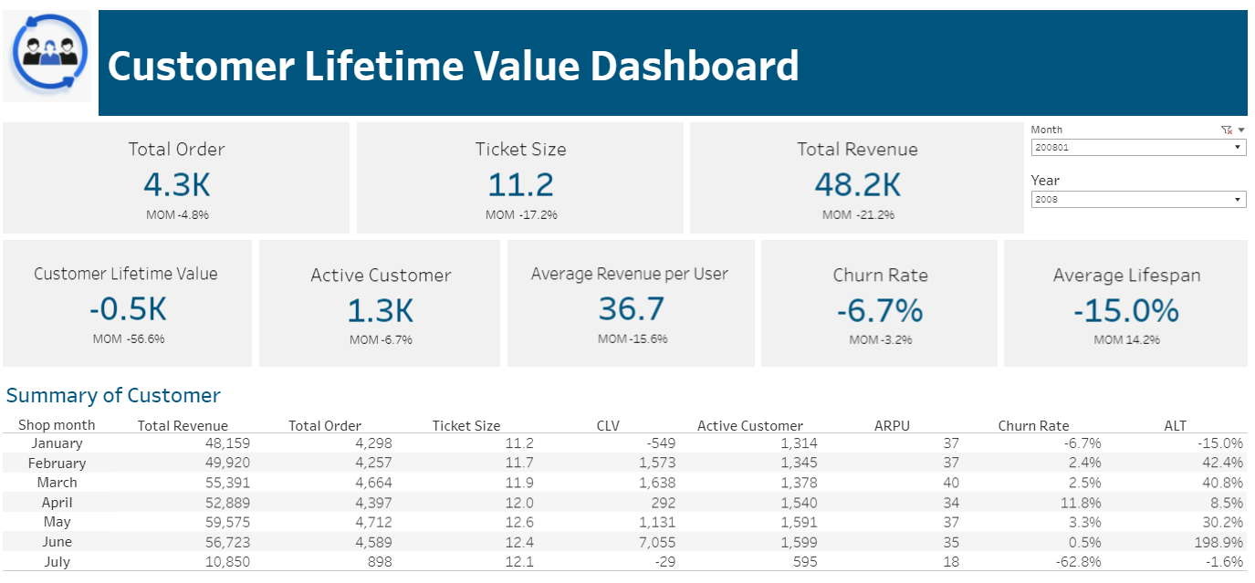
https://public.tableau.com/shared/P54HHN3Y4?:display_count=n&:origin=viz_share_link

